Slide 1
The BEDTools suite
Cem Azgari

Slide 2
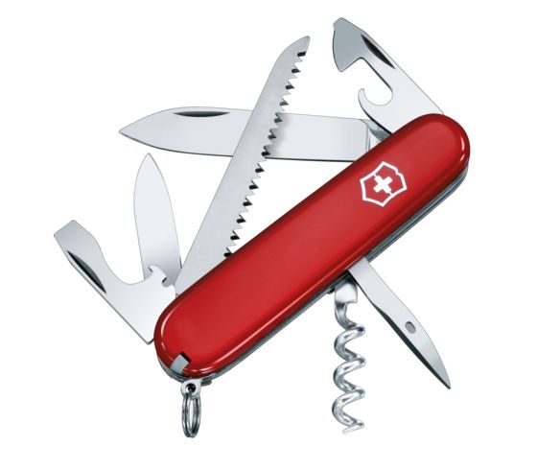
BEDTools Overview
A software suite to compare, manipulate and annotate large sets of genomic features.
Time efficient and flexible, even for very large datasets.
Designed to be used in a UNIX environment and easily works with existing bash commands. Very useful for organizing pipelines.
Works primarily with BED files, but has expanded to other file types as well, such as GFF and VCF.
A.K.A: swiss-army knife

Slide 3
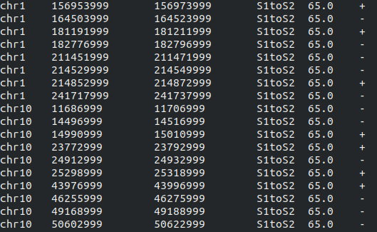
BED (Browser Extensible Data) File Format
Chromosome
Start position
End position
Name
Score
Strand
A simple tab delimited file.
Contains regions of the genome.
Used to restrict analysis to target regions.
Used in analysis of NGS based data.

Slide 4
Setup
Create a directory:
A mkdir bedtools-tutorial/
Move to the directory:
cd bedtools-tutorial/
Clone git repository:
git clone https://github.com/azgarian/bedtools-tutorial.git
Load the bedtools module:
module load bedtools2-2.29.1-gcc-8.2.0-skptudb

Slide 5
BEDTools Sub-commands
Utility | Description
intersect | Find overlapping intervals in various ways.
merge | Combine overlapping/nearby intervals into a single interval.
genomecov | Compute the coverage over an entire genome.
complement | Extract intervals _not_ represented by an interval file.
flank | Create new intervals from the flanks of existing intervals.
makewindows | Make interval "windows" across a genome.
getfasta | Use intervals to extract sequences from a FASTA file.
To check the full list of sub-commands, enter the code bedtools or visit the bedtools website.

Slide 6
Files used for the tutorial
File | Description
genome.bed/txt | Contains length of each chromosome
hg38_gencode_v32_exons_introns.bed | Contains the exons and introns of all the genes at gencode version 32
UV_damage.bed | UV induced damage regions of HeLa cells.
UV_repair.bed | UV induced repair regions of HeLa cells.
questions.md | Contains the questions which we will answer together during this tutorial

Slide 7
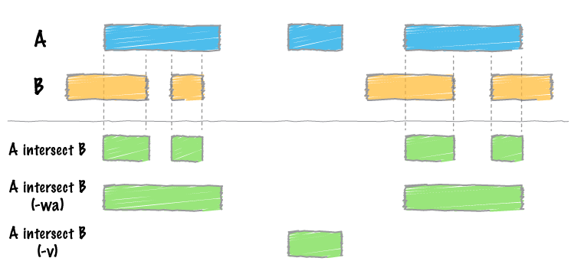
Sub-command: intersect

Slide 8
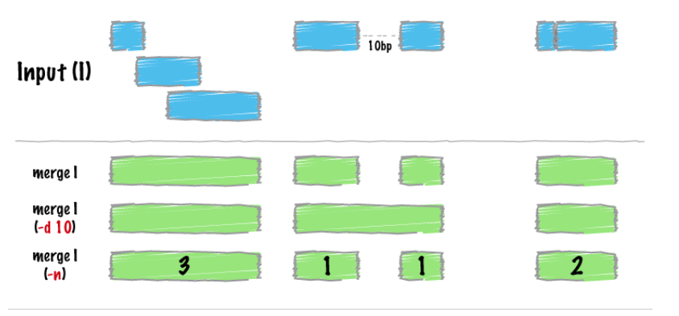
Sub-command: merge

Slide 9
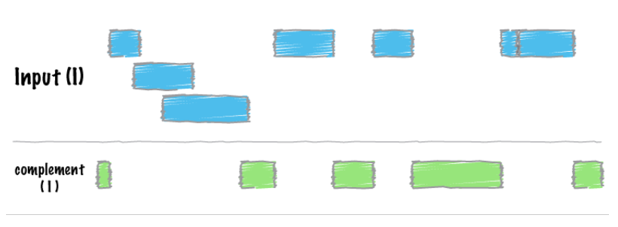
Sub-command: complement

Slide 10
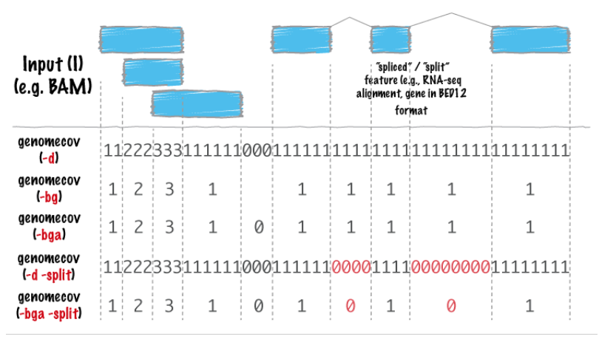
Sub-command: genomecov

Slide 11
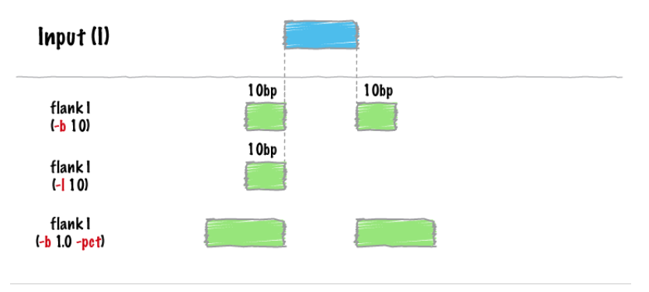
Sub-command: flank

Slide 12
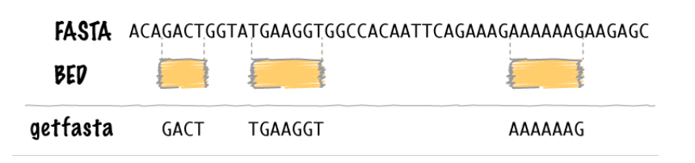
Sub-command: getfasta

Slide 13
References
a powerful toolset for genome arithmetic. (2020) Retrieved from https://bedtools.readthedocs.io/en/latest/
Frequently Asked Questions: Data File Formats. (2020). Retrieved from http://genome.ucsc.edu/FAQ/FAQformat#format1
Quinlan, A. R., & Hall, I. M. (2010). BEDTools: a flexible suite of utilities for comparing genomic features. Bioinformatics, 26(6), 841-842.

